Slide 1
Text Summarization
Using
Sig Space Framework
Manikanta Maddula (15)
Team 13
Guided by
Dr. Yugyung Lee

Slide 2
Introduction
• In the era of big data, it is essential to explore the
opportunities in discovering knowledge from big data.
• However, traditional machine learning approaches are
not well fit to analyze the full value of big data.
• Patterns in Different text data to solve several problems.
• Specifically, current research and practice of machine
learning do not fully support some important features
for big data analytics such as incremental learning,
distributed learning and fuzzy matching.

Slide 3
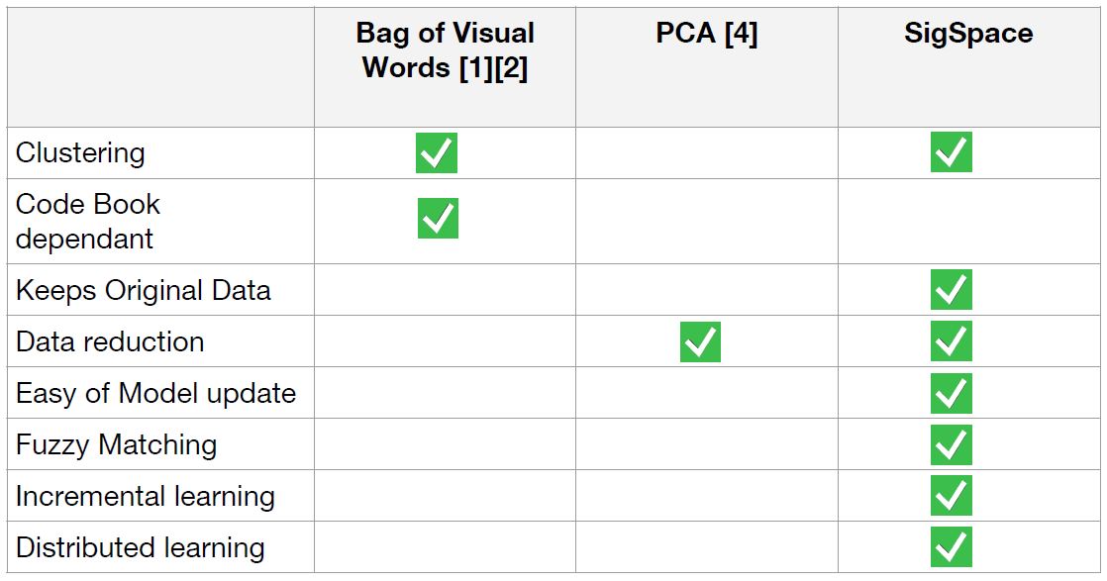
Sig Space Comparison

Slide 4
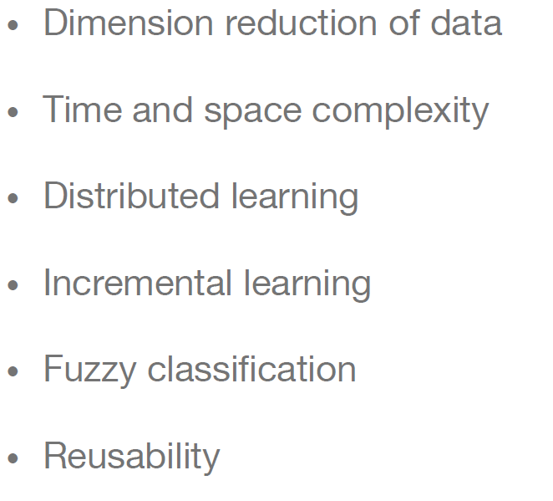
Sig Space advantages

Slide 5
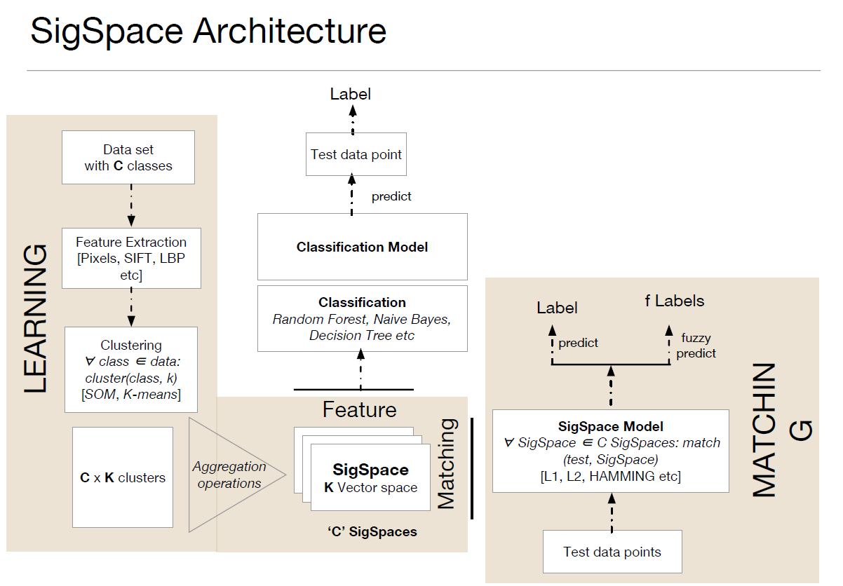
(Image Clustering)

Slide 6
Self Organizing Map
Ideas first introduced by C. von der Malsburg (1973), developed and refined by T. Kohonen (1982)
Neural network algorithm using unsupervised competitive learning
Primarily used for organization and visualization of complex data
Biological basis: ‘brain maps’
Maps multidimensional data onto a low dimensional data (usually 2 or 1 dimensions).
The projection preserves the topology of the data so that similar data items will be mapped to nearby locations on the map.

Slide 7
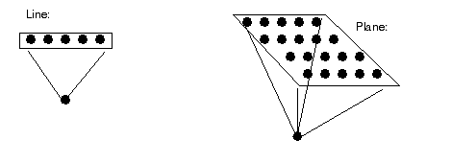
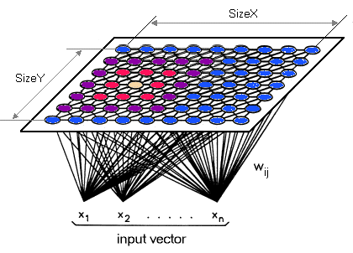
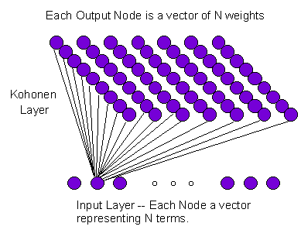
SOM

Slide 8
SOM Algorithm
Randomly initialise all weights
Select input vector x = [x₁, x₂, x₃, … , x_{n}]
Compare x with weights w_{j} for each neuron j to determine winner
Update winner so that it becomes more like x, together with the winner’s neighbours
Adjust parameters: learning rate & ‘neighbourhood function’
Repeat from (2) until the map has converged (i.e. no noticeable changes in the weights) or pre-defined no. of training cycles have passed

Slide 9
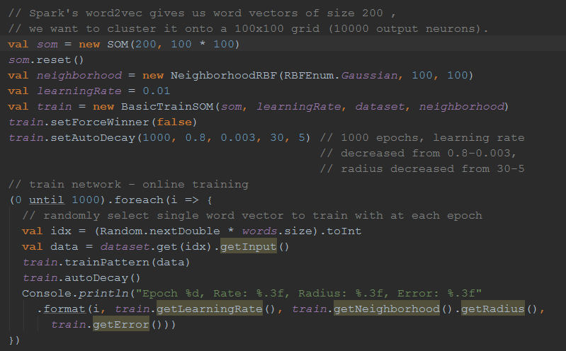
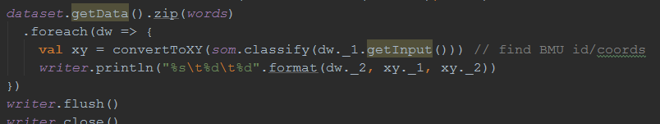
Encog machine Learning Package

Slide 10
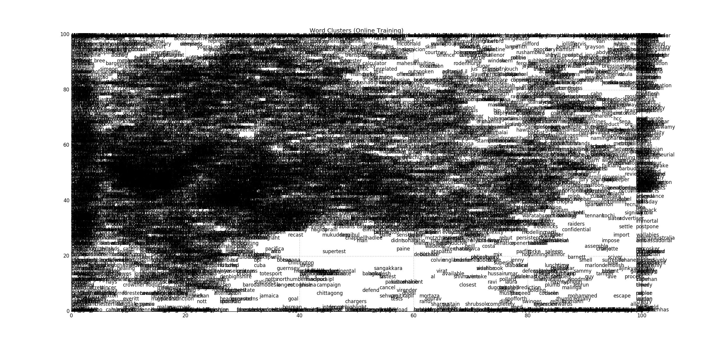
SOM Dimension Reduction:
Plotted using pyplot library in python

Slide 11
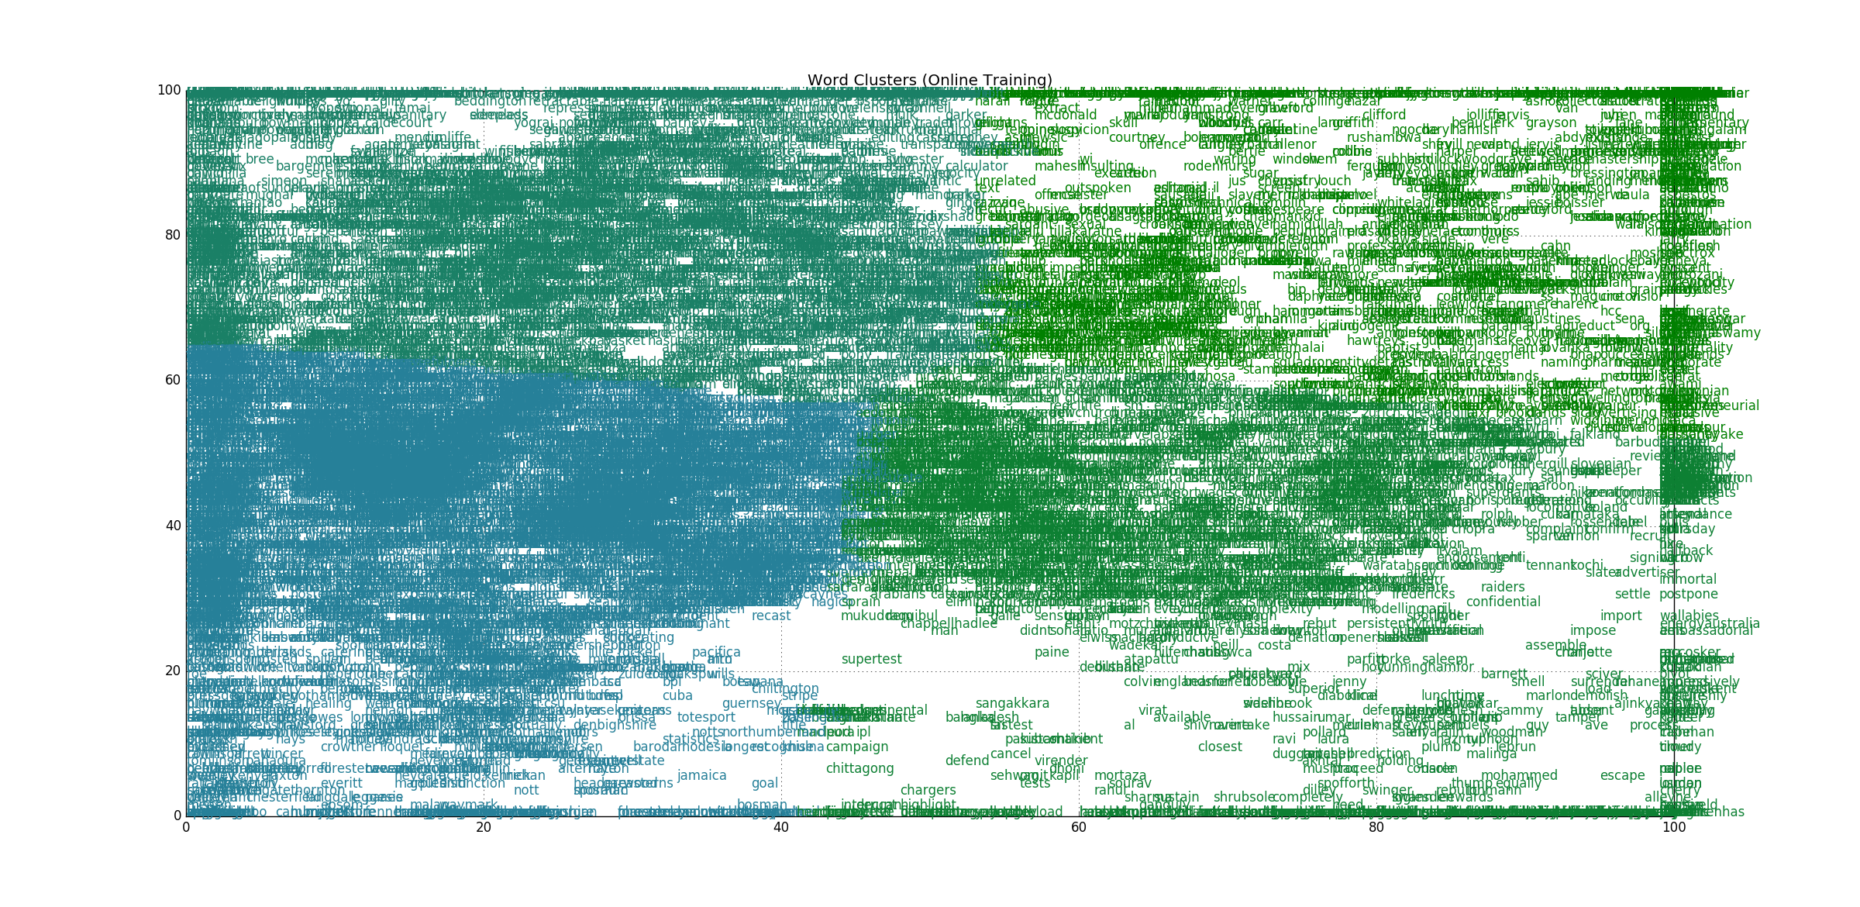
Visualization: SOM-> kMeans clustering
Sample 4 clusters for 4 classes

Slide 12
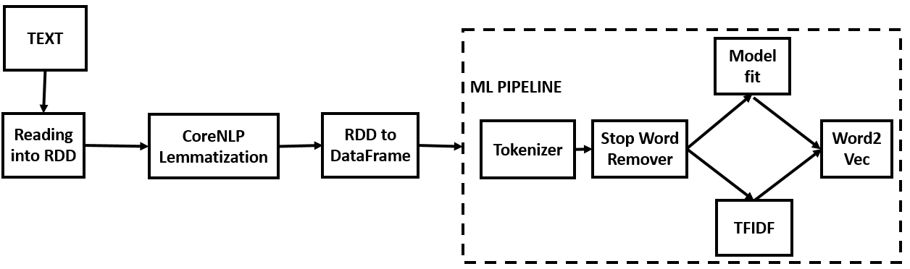
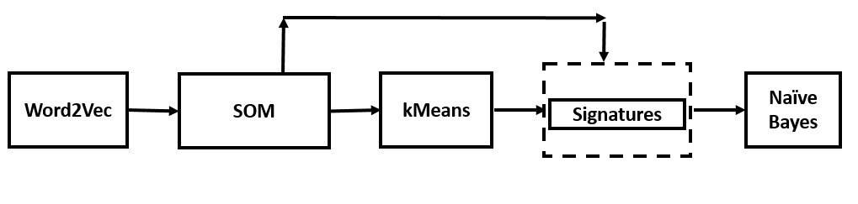
Training Workflow

Slide 13
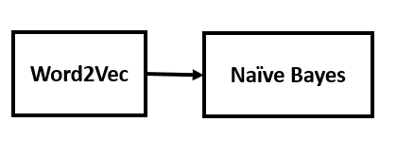
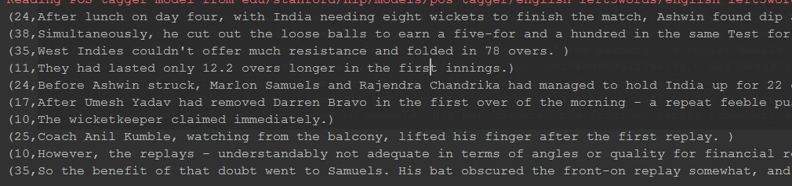
Traditional Workflow
Sample Output

Slide 14
Text Summarization
Based on Naïve Bayes predicted probabilities
Classification and predicted probabilities are generated for each sentence in the input. Sentences fall into different topics inside each class. More number of classes (predicted) decide the class to be considered. After that a threshold of predicted probability is used to summarize the data.

Slide 15
Training Data
BBC Sport website corresponding to sports news in five topical areas from 2004-2005 with 737 documents and 4 natural classes. Source: http://mlg.ucd.ie/datasets/bbc.html
20 Newsgroups data set is a collection of approximately 20,000 newsgroup documents, partitioned (nearly) evenly across 20 different newsgroups. Source: http://qwone.com/~jason/20Newsgroups/
Wikipedia dataset for 4 classes is collected (Cricket, Rugby, Tennis, Football) and parsed using python program
https://petscan.wmflabs.org/
https://en.wikipedia.org/wiki/Special:Export

Slide 16
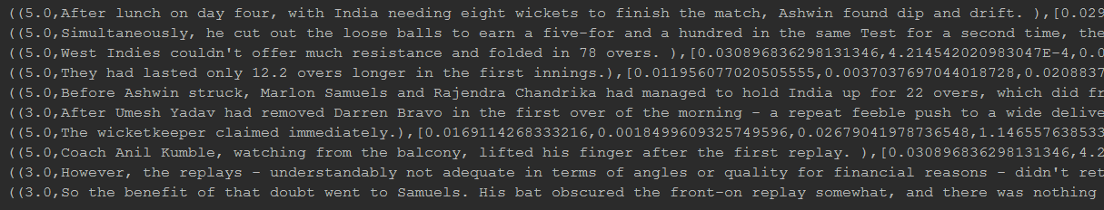
Evaluation
Sample output:

Slide 17
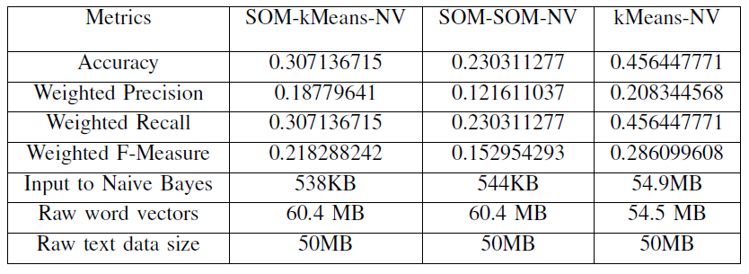
Evaluation
Different Approaches

Slide 18
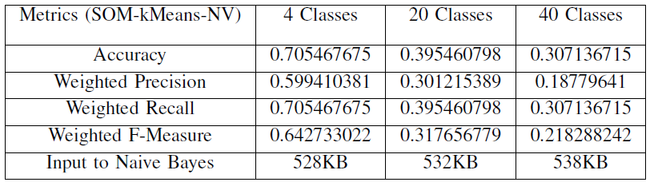
Evaluation
Number of Classes

Slide 19
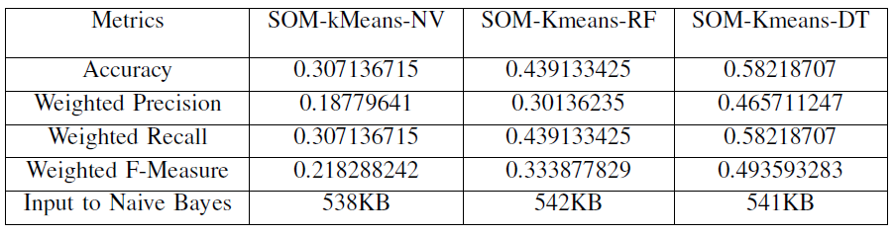
Evaluation
Different Classifiers

Slide 20
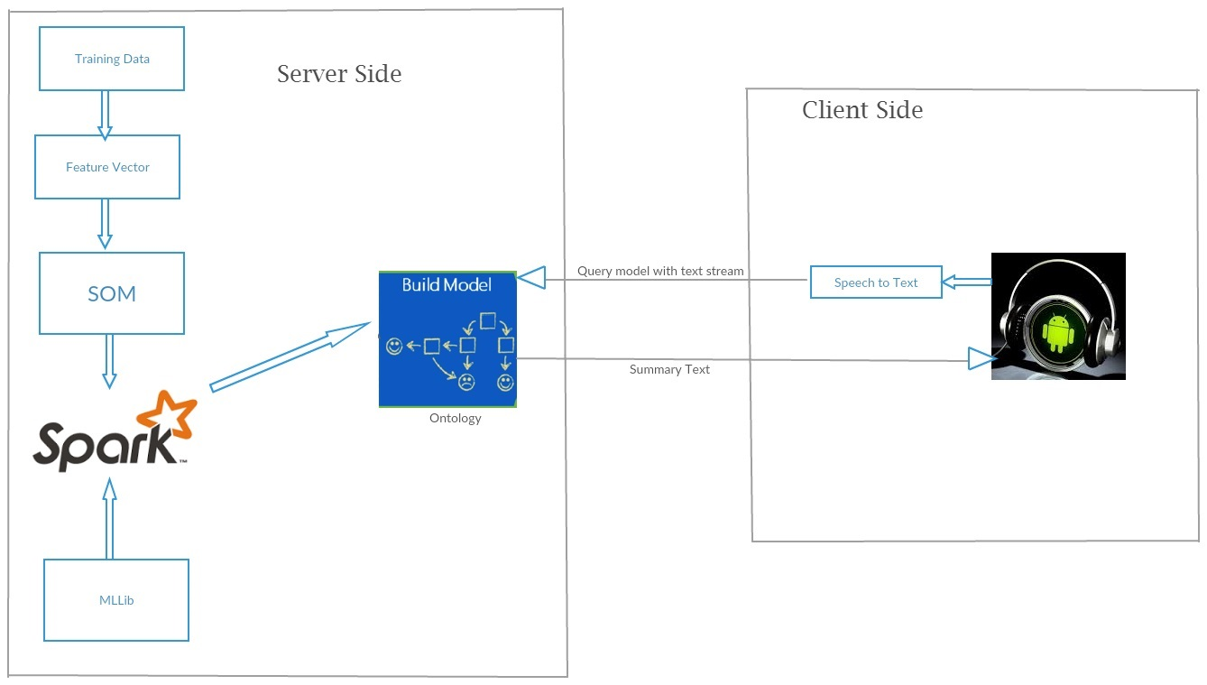
iHear – Hearing Aid

Slide 21
Thanks Dr. Yugyung Lee Mayanka Chandra Sekhar

